Slide 1
PROSTHETIC HEART VALVE :
Types, Selection, and Functional assessment
Dr SHAJUDEEN
2nd Year DM Resident

Slide 2
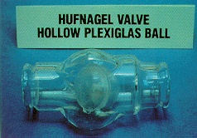
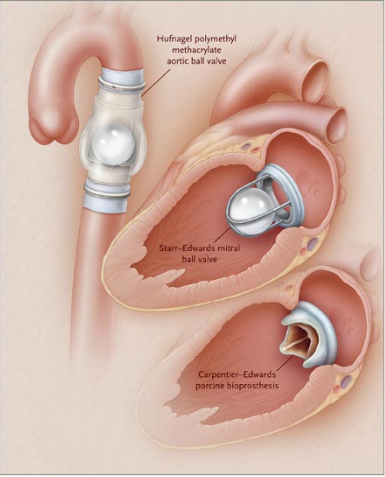
HISTORY OF PROSTHETIC HEART VALVE
First Mechanical valve was designed by Charles Hufnagel in 1954 ( Implanted in descending thoracic aorta for AR)
Plexiglass (Methyl Methacrylate)cage
&
Silicone-coated nylon poppet

Slide 3
Dwight Harken perfomed the first aortic valve replacement in 1960
Nina Braunwald implanted the first Ball and cage valve in Mitral position in 1960

Slide 4
Homograft was first developed by Donald Ross
Porcine valve was first implanted by Binet et al.
Alian Carpenter discovered Gluteraldehyde Fixation
The name “Bioprosthetic “valve was coined by Carpentier.
David implanted the first stentless porcine bioprosthesis in
1988
Ross & Boyes performed the first successful
allograft replacement from cadaver in 1962

Slide 5
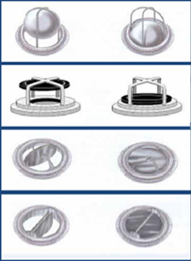
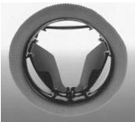
ADVANCEMENT IN PHV TECHNOLOGY
Ball and cage
Ball and Disc
Titling Disc
Bileaflet
New Generation valve
( Trileaflet valve) under Trial
Porcine valve
Pericardial valve
Stentless valves (1988)
Trans catheter Prosthesis

Slide 6
Changes in Valve Processing Technology
Formaldehyde fixation
Anticalcification treatment( Alpha oleic acid (AOA) &
Polysorbate 80)
Gluteraldehyde fixation under
Normal pressure
Zero pressure fixation
AOA binds to the bioprosthetic tissue & inhibit calcium flux
Gluteraldehyde fixation advantages
Cross links Collgen fibers
Reduces
Tissue antigenicity
Enzymatic degradation
Cell viability
Problem with the High Pressure fixation
Early matrix fragmentation &
Premature valve degeneration

Slide 7
Prosthetic Heart valve

Slide 8
PROSTHETIC HEART VALVE CLASSIFICATION
MECHANICAL PROSTHETIC HEART VALVES
BALL &CAGE
TILTING DISC
BILEAFLET VALVES
BIOPROSTHETIC HEART VALVES
AUTO GRAFT
HOMOGRAFT
HETERO GRAFT
STENTED : PORCINE or PERICARDIAL
STENTLESS : PORCINE
Homograft : From Human cadaver
Heterograft : From Porcine or Bovine

Slide 9
PHV valves: Advantages and Disadvantages
Mechanical heart valve
Bioprosthetic heart valves
Advantage
Durability high
Disadvantage
Thrombosis & Thromboembolism risks high so life long anticoagulation
Advantage
Prolonged anticoagulation
not needed
Disadvantages
Limited durability.
Structural valve degeneration

Slide 10
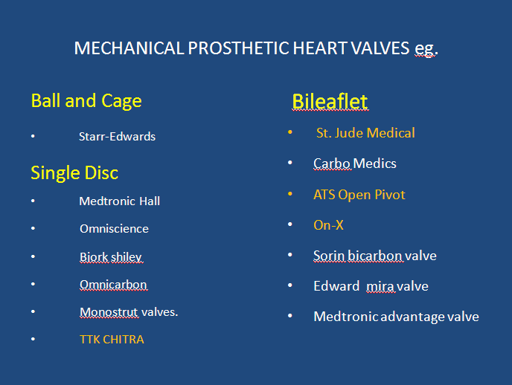
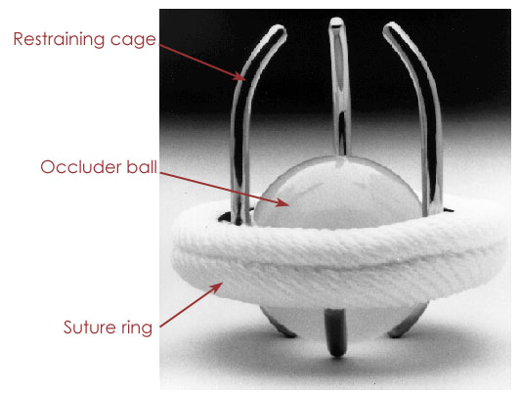
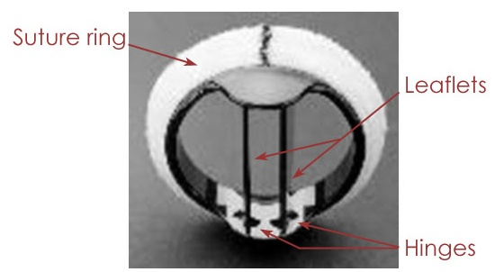
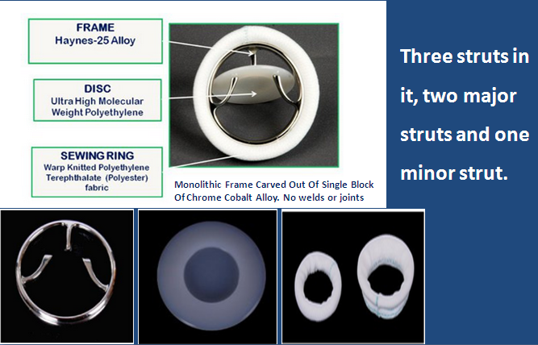
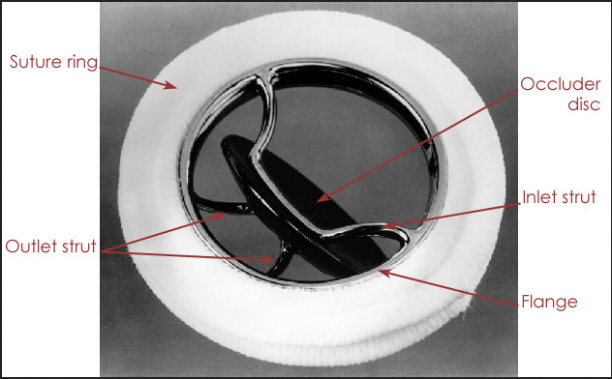
Mechanical PHV Basic structure
TTK-CHITRA
The ball is a silicone rubber polymer, impregnated with barium sulfate for radiopacity, which oscillates in a cage of cobalt-chromium alloy

Slide 11
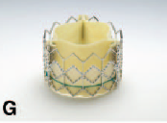
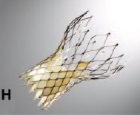
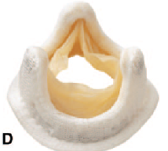
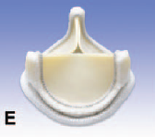
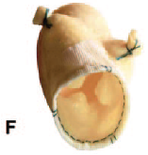
BIOPROSTHETIC HEART VALVES
Stented Porcine
Stented pericardial
Medtronic Hancock
Hancock Modified Orifice
Carpentier-Edwards Standard
Medtronic Hancock II
Medtronic Mosaic
Carpentier-Edwards Supra-annular
Carpentier-Edwards Perimount
Carpentier-Edwards Magna
  Percutaneous Bioprosthetic valves
  Edwards Sapien (Expanded over a balloon)
  CoreValve (Self –expandable)
Stentless valve
Medronic Freestyle (Porcine xenograft).

Slide 12
Mechanical valve types merits and demerits

Slide 13
Ball and Cage Advantage of the design
Advantages
Disadvantage
Occluder travel completely out of orifice reducing the possibility of thrombus or pannus growing from the sewing ring to interfere with the Valve Mechanism
Continous changing point of contact of the ball reduces the wear and tear in any one area
  Central flow Obstruction
  Collisions with the occluder ball causes damage to blood cells.
Bulky cage design so not suitable for if small LV cavity. or small aortic annulus.
Thrombogenic risk is slightly higher ie 4% to 6% per year

Slide 14
TILTING DISC : KEY FEATURES

Slide 15
Tilting disc Advantage & Disadvantages
Advantage over Ball & Cage
Thrombus and Pannus interfering with the motion of disc
Careful orientation of disc needed during implantation
Disadvantage
  Low profile
  Central blood flow.
  Decrease turbulence
  Reduce shear stress.
  Thrombotic risk is reduced

Slide 16
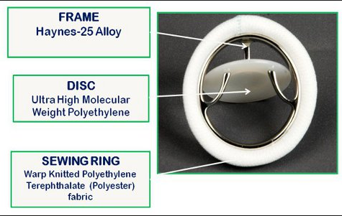
TTK-CHITRA:ADVANTAGES
ONLY INDIAN-MADE HEART VALVE
Complete structural integrity
Silent operation
Rotatable within the sewing
ring to assure its freedom to
rotate if repositioning needed.
Low profile, most price-friendly
Low thromboembolism even if
poor anticoagulant compliance

Slide 17
Bileaflet valves advantages over single disc
Carbon leaflets and flange exhibit high strength and excellent biocompatibility
Largest opening angle
Low turbulence.
Low bulk and flat profile
Easier insertion
Superior hemodynamics
Lower transvalvular pressure gradient at any outer diameter and cardiac output than caged ball or tilting disc valves
Thrombogenicity in the mitral position may be less than that associated with other prosthetic valves

Slide 18
Bioprosthetic valves : Key features

Slide 19
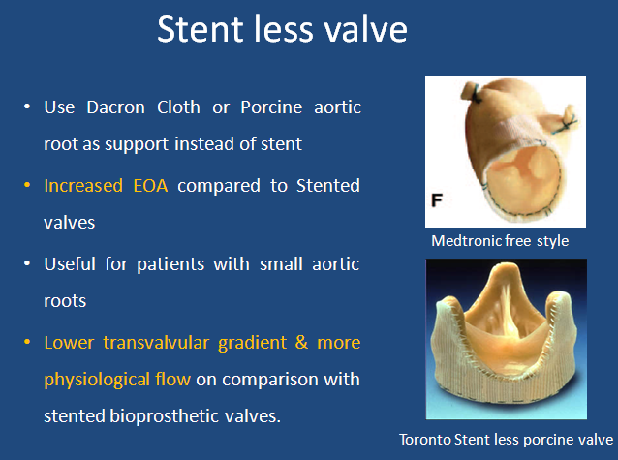
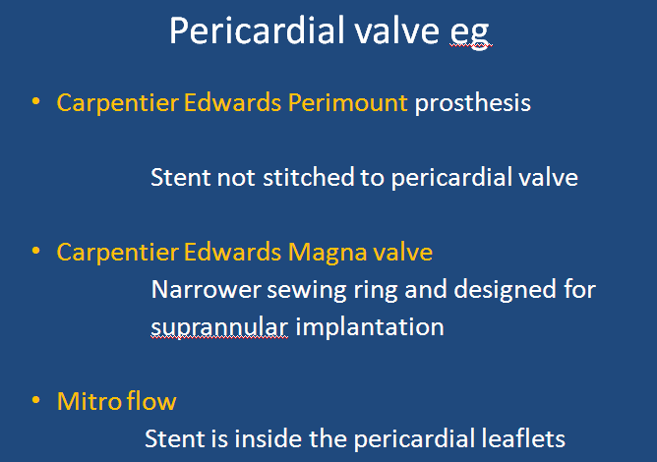
Pericardial valve:
Made from Bovine pericardium mainly but from Porcine or Equine also.
Pericardial valve are invariably stented
Increased durability due to increased amount of collagen
More symmetrical function of leaflet so better hemodynamics

Slide 20
Homograft (Allograft) Aortic Valves
Harvested from cadavers usually within 24 hours of donor death
Insertion: usually in the Aortic position without a prosthetic stent and implanted in the subcoronary position with valve alone or the valve and a portion of aorta are implanted as a root replacement, with reimplantation of the coronary arteries into the graft

Slide 21
Pulmonary Autografts
Ross procedure : Patient's own pulmonary valve and adjacent main pulmonary artery are removed and used to replace the diseased aortic valve with reimplantation of the coronary arteries in to the graft.
The autograft is non thrombogenic and no anticoagulation is needed
Risk of Endocarditis is very low.

Slide 22
NEXT GENERATION VALVE
The next generation of mechanical valves is the tri-leaflet which more closely mimics natural heart valve function and has improved hemodynamics and the potential for greatly reduced thrombosis risks.

Slide 23
SELECTION OF PROSTHETIC HEART VALVE

Slide 24
Factors to be considered while selecting a prosthetic heart valve
Age of the patient
Comorbid condition ( cardiac and non cardiac)
Expected lifespan of the patient
Long term outcome with the prosthetic heart valves
Patient wishes
Skill of the surgeon
Women of child bearing ages

Slide 25
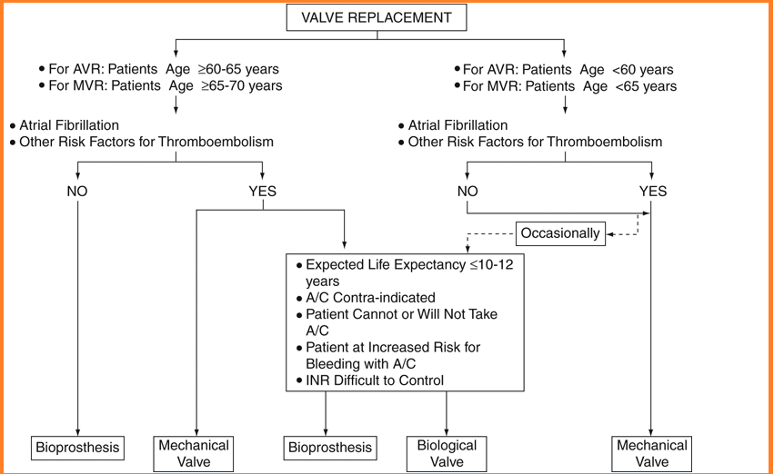

Slide 26
For valve replacement for IE: Homograft preffered
For Narrow aortic root if root enlargement/replacement not possible choice is Bileaflet valves.

Slide 27
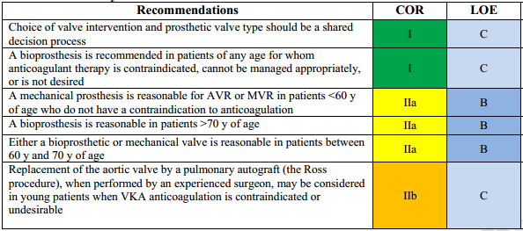
ACC Guidelines for selection of PHV

Slide 28
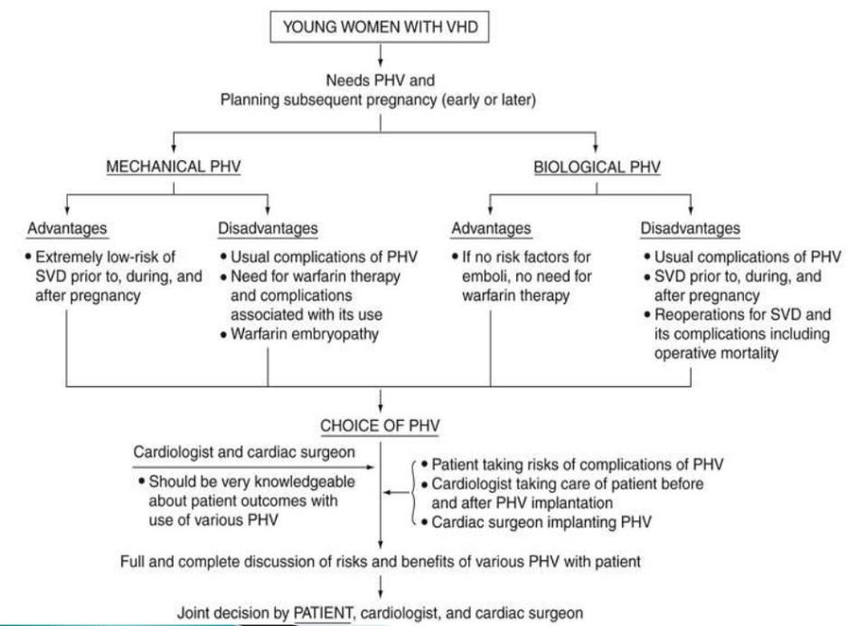
PHV Selection in Pregnancy

Slide 29
Evaluation of prosthetic valves

Slide 30
Evaluation of prosthetic valves
CLINICAL INFORMATION &CLINICAL EXAMINATION
IMAGING OF THE VALVES
CXR
2D echocardiography
TEE
3D echo
CineFluoro
CT
Cardiac catheterisation

Slide 31
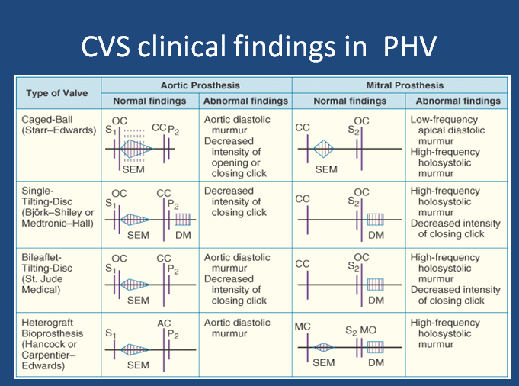
CLINICAL INFORMATION
Clinical data : Reason for the study & the patient’s
symptoms
Type & size of replaced valve.
Date of surgery.
Patient’s height, weight, and BSA should be recorded to assess whether prosthesis-patient mismatch (PPM) is present
BP & HR
  HR particularly important in mitral and tricuspid evaluations because the mean gradient is dependent on the diastolic filling period

Slide 32
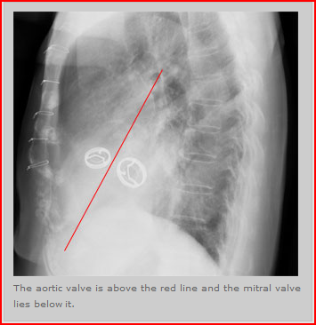
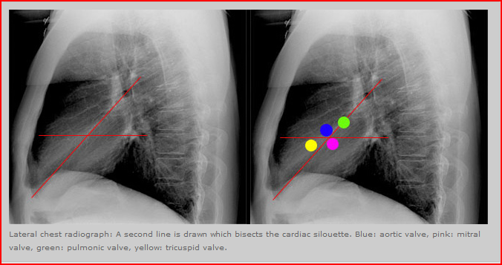
X-Ray in PHV : Identification of Valves
Carina
AV
MV
Apex

Slide 33
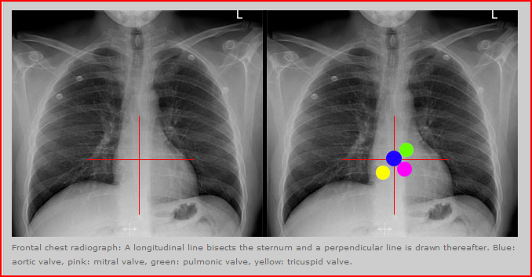
Chest X ray AP View
The Aortic valve - intersection of these two lines.
The Mitral valve - lower left quadrant (patient’s left).
The Tricuspid valve - lower right corner (the patient's right)
The Pulmonic valve- upper left corner (the patient's left).

Slide 34
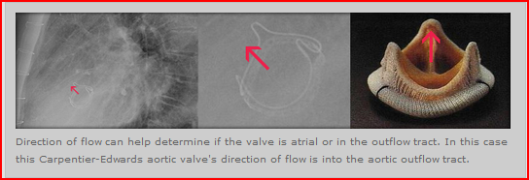
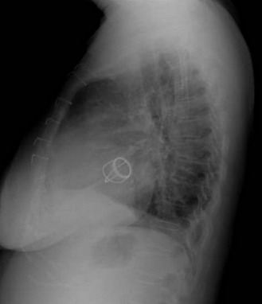
Determination of site of valve by assesing the direction of flow
If the direction of flow is from
Inferior to superior – likely aortic valve.
Superior to inferior- likely a mitral valve.

Slide 35
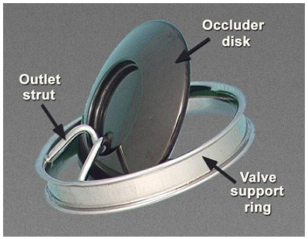
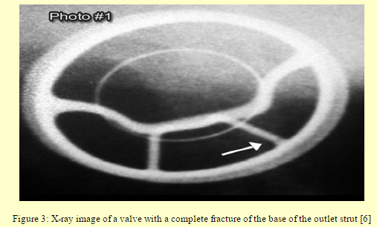
X-ray detection of complication:
Strut fracture in Bjork shiley
Bjork Shiley PHV Normal structure

Slide 36
Cinefluoroscopy
Structural integrity
Motion of the disc or poppet
Excessive tilt ("rocking") of the base ring - partial dehiscence of the valve. A rocking motion of greater than 15⁰ of sewing-ring excursion is abnormal
Aortic valve prosthesis - RAO caudal
- LAO cranial
Mitral valve prosthesis - RAO cranial .

Slide 37
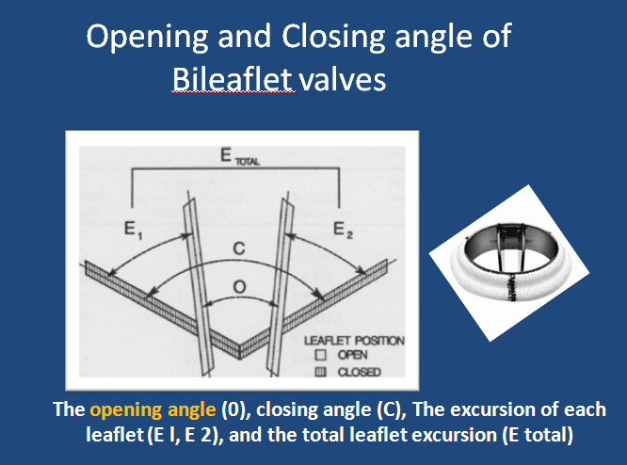
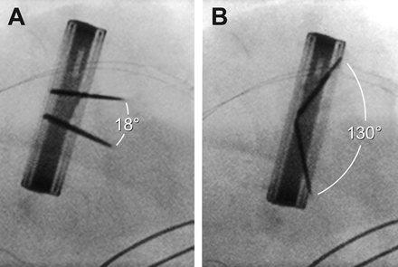
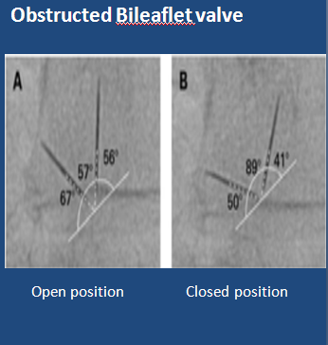
Concept of Opening and closing angle:
Evaluation of prosthetic valves-Cinefluoroscopy
 | Opening angle
Medronic hall | 75⁰
St Jude Medical standard &, Reagent, On X | 85⁰
CarboMedics standard | 78⁰

Slide 38
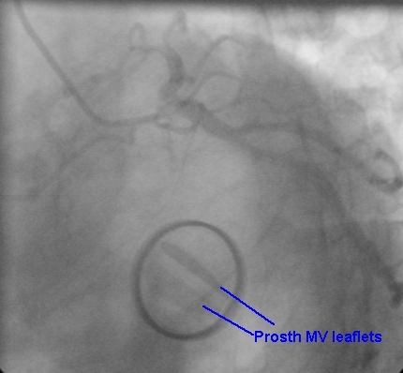
St. Jude medical bileaflet valve

Slide 39
ECHO ASSESSMENT OF PROSTHETIC HEART VALVES

Slide 40
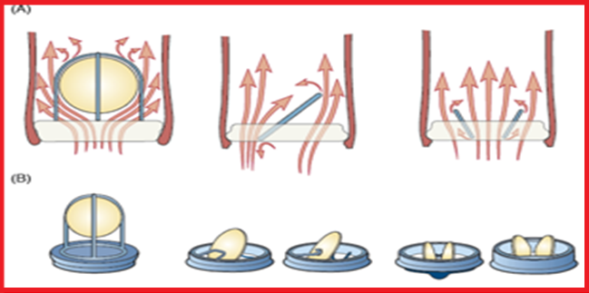
Flow dynamics of different types of PHV
Ball & Cage
Tilting disk
Bileaflet

Slide 41
Echo in PHV Evaluation : General consideration
Compared with a native valve the prosthetic valves are inherently stenotic.
The type and size of prosthesis determines what is considered normal function for that valve. So gradients, EOA, and degree of physiologic regurgitation will vary based on valve type, manufacturer, and valve size.

Slide 42
Echo in PHV Evaluation : General consideration
Always use multiple views during echo evaluation of PHV.
For Stented valves-ultrasound beam aligned parallel to flow to avoid the shadowing effects of the stents and sewing ring

Slide 43
Echo in PHV Evaluation : General consideration
Complete evaluation requires TTE and TEE.
TEE is ideal for visualizing the LA, Pul. Veins &
LA side of the prosthesis
Echo Artifacts due to PHV:
Acoustic shadowing
Reverberation
Refraction & Mirror artifacts.

Slide 44
Doppler assessment:General consideration
High sweep speeds (100 mm/s) increases the accuracy of Doppler measurements.
Doppler Quantitative Parameters should be averaged from 1 to 3 cycles in sinus rhythm and 5 to 15 cycles in atrial fibrillation to increase accuracy

Slide 45
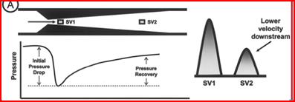
The concept of pressure recovery

Slide 46
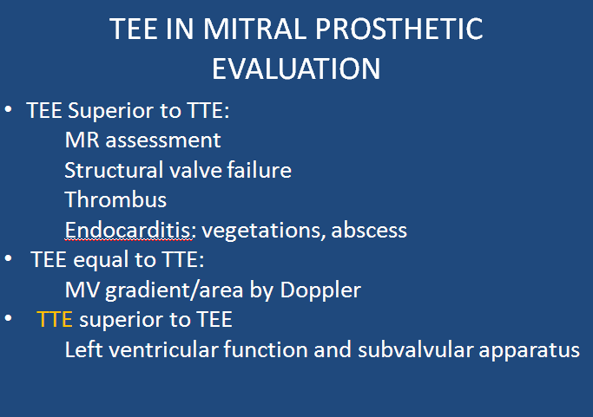
TEE Views
The most useful views include the mid esophageal 4-chamber, 2-chamber, & 3-chamber views.
Transgastric views may be useful when assessing LV size and function or papillary muscle and chordal anatomy.

Slide 47
ECHO FEATURES OF BILEAFLET VALVE
Both leaflets are typically visualized .
Opening angle 75⁰ to 90⁰
Closing position
120⁰ for valves ≤25 mm & 130⁰ for valves ≥27 mm
Three orifices are seen in diastole with highest
velocity from central orifice
Small flame-shaped washing jets of MR are seen
Bileaflet have the largest EOA of all the mechanical valves (2.4–3.2 cm²) with little intrinsic mitral regurgitation (MR).

Slide 48
ECHO features of Tilting disc features
Closing angle of disc between 110⁰ to 130⁰ &
Opening angle of 60⁰ to 80⁰
The Orifices for these valves are Asymmetric
Major orifice at the site of forward
Disc excursion (in the direction of flow)
& Minor orifice at the site of retrograde
disc excursion.
The EOA of these valves ranges from 1.5 to 2.1 cm²

Slide 49
Major and minor orifice disc angle ranging
from 60⁰ to 80⁰
Normal backflow 5 to 9 mL/beat
Marked turbulence is created if the major
orifice faces the left ventricular outflow
tract (LVOT)

Slide 50
PHV Flow Cx: Important feature.
Valve type | Flow Characteristics
Ball-in-cage prosthetic valve (Starr-Edwards, Edwards Lifescience) | Much obstruction and little leakage.
Tilting disc prosthetic valve (Björk-Shiley; Omniscience; Medtronic Hall) | Less obstruction and More leakage.
Bi leaflet prosthetic valves (St. Jude Medical; Sorin Bicarbon; Carbomedics) | Less obstruction and More leakage.
Bioprostheses. | Little or no leakage
Homografts, pulmonary autografts, and unstented bioprosthetic valves (Medtronic Freestyle, Toronto, Ontario, Canada) | No obstruction to flow.
Stented bioprostheses (leaflets suspended within a frame) | Obstructive to flow.

Slide 51
2D ECHO assessment of PHV

Slide 52
TIMING OF ECHO CARDIOGRAPHIC FOLLOW-UP
Baseline postoperative TTE study should be performed 3-12weeks after surgery, when the
  Chest wound has healed
  Ventricular function has improved.
  Anaemia with its associated hyperdynamic state has resolved.
Bioprosthetic valves Annual echocardiography is recommended after the first 10 years. If symptom of dysfunction echo indicated SOS
Mechanical valves routine annual echocardiography is not indicated in the absence of a change in clinical status.

Slide 53
2D ECHO ASSESMENT
Valves should be imaged from multiple views, Points to note are
Determine the specific type of prosthesis.
Confirm the opening and closing motion.
Confirm stability of the sewing ring.
  Presence of leaflet calcification or abnormal echo density –
  (vegetations and thrombi)
  Confirm normal blood flow patterns
Calculate valve gradient
Calculate effective orifice area
Detection of Pathologic transvalvular and paravalvular
regurgitation.

Slide 54
2D Echo complication detection
For bioprostheses, evidence of leaflet degeneration can be recognized
    leaflet thickening (cusps >3 mm in thickness)-earliest sign
    calcification (bright echoes of the cusps).
    Tear (flail cusp).
Prosthetic valve dehiscence is characterized by a rocking motion of the entire prosthesis.
An annular abscess may be recognized as an echolucent or echodense irregularly shaped area adjacent to the sewing ring of the prosthetic valve.

Slide 55
Doppler Echocardiography in PHV evaluation

Slide 56
PRIMARY GOALS OF DOPPLER INTERROGATION
Assesment of prosthetic valve obstruction
Detection and quantification of prosthetic valve regurgitation

Slide 57
Doppler Assessment of Obstruction of Prosthetic Valves Stenosis
Quantitative parameters of Prosthetic valve Stenosis
  Trans prosthetic flow velocity & Pressure gradients.
  Valve EOA.
  Doppler velocity index(DVI).
  Contour of trans prosthetic jet and acceleration time (AT)¥
  ¥ For Prosthetic Aortic valve Stenosis

Slide 58
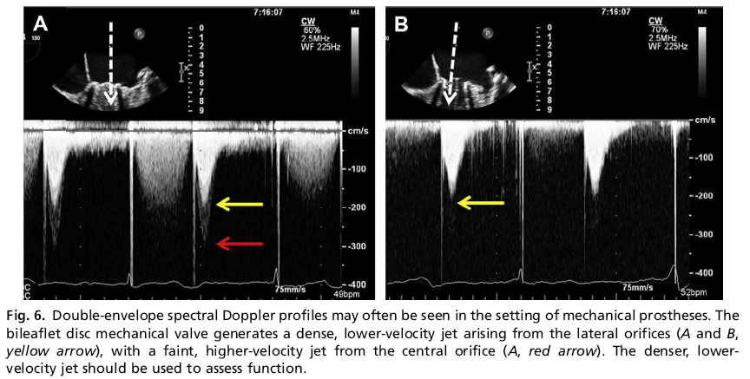
Double envelope spectral doppler

Slide 59
Aortic valve: Trans prosthetic valve velocity & Gradient assessment.
Take values from multiple transducer position
Apical
Right parasternal
Right supraclavicular
Suprasternal notch
Take highest velocity from the different values obtained from various position

Slide 60
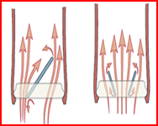
Transprosthetic velocity and gradient
The flow is
Eccentric - monoleaflet valves
Three separate jets - bileaflet valves
Multi-windows examination needed
Localised high velocity may be recorded by continuous wave(CW) Doppler
Interrogation through the smaller central orifice of the bileaflet mechanical prostheses
overestimation of gradient

Slide 61
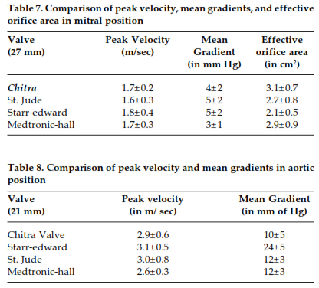
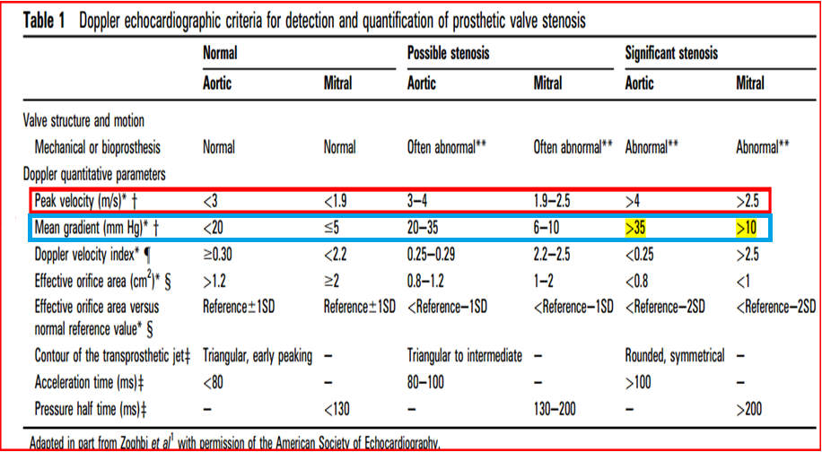
Prosthetic Heart valve Gradient calculation.
Equation
Δ P = 4V²
or
If LVOT velocity more than 1.5 cm²
Δ P =4 (V_{PRAV}² - V_{LVOT}²)
Limitation of doppler transvalvular Gradient measurement is that it is FLOW DEPENDENT

Slide 62
Effective orifice area calculation (EOA) of Aortic PHV
Continuity equation used mostly.
EOA _{PrAV} = (CSA _{LVOT} x VTI _{LVOT}) / VTI _{PrAV}
This method can be applied even if concomitant aortic regurgitation.
Better for bioprosthetic valves and single tilting disc
mechanical valves.
Underestimation of EOA in case of bileaflet valves.
PHT is used only if <200 msec or > 500 msec.
Notes:
measurementis
often difficult because of the reverberations and
artefactscausedbythe prosthesisstentorsewing
ring

Slide 63
Calculation of EOA at the Mitral Prosthetic valve
EOA_{PrMv} = CSA LVOT X VTI _{LVOT} /VTI _{PrMv}
Continuity equation can’t be applied for mitral PHV EOA calculation if > mild MR/AR present.
PHT is also not valied for MPHV EOA calculation as it is influenced by the chronotropy , LA & LV compliance.
If PHT significantly delayed (>130msec) or show significant lengthening from the value obtained during the last evaluation it is useful.

Slide 64
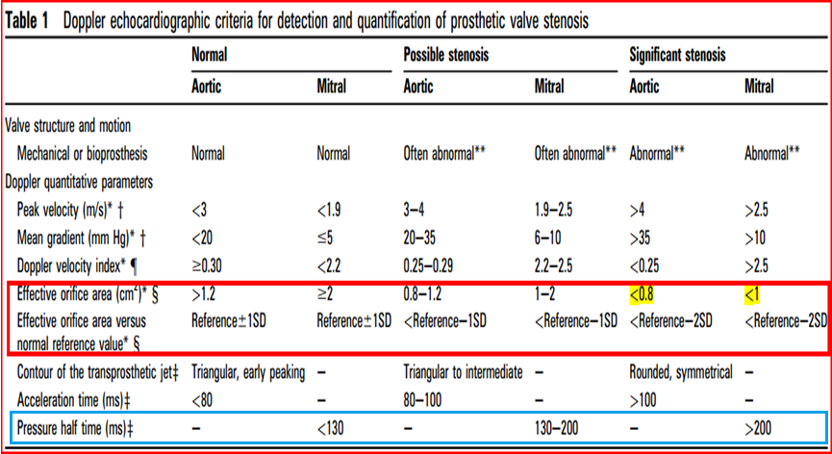
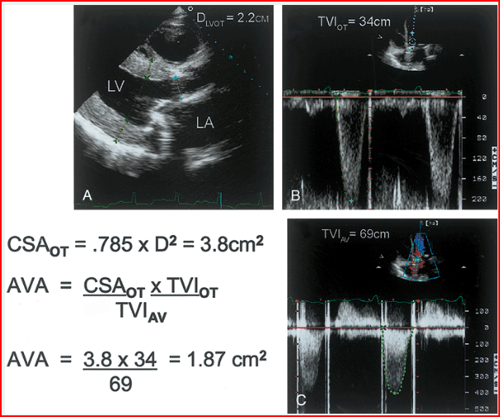
How to take measurement for continuity equation
VTI _{LVOT} by PW doppler at LVOT at the same location at which LVOT diameter taken ie 0.5 -1 cm distal to the LVOT.
VTI _{PRAV} : CW at the Aortic prosthesis
CSA _{LVOT}: PLAX zoomed view ie 0.5 -1 cm distal to the LVOT.

Slide 65
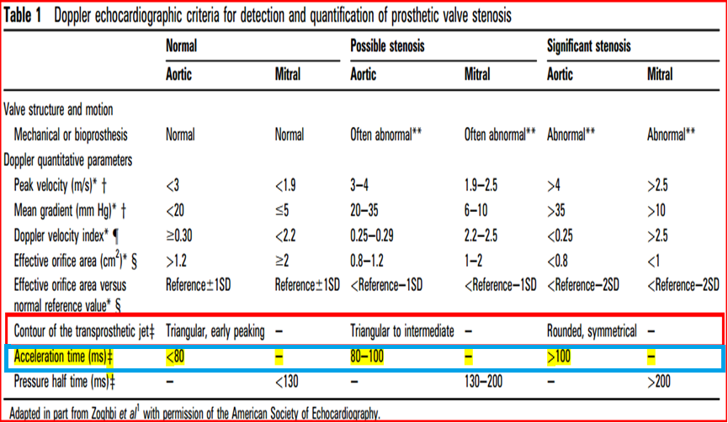
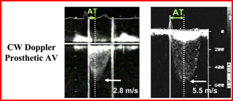
Transprosthetic jet contour and Acceleration time :Qualitative index
Normal Contour: Triangular & short AT
PHVObstruction: Rounded contour with peaking at mid ejection time & prolonged AT(>100msec)

Slide 66
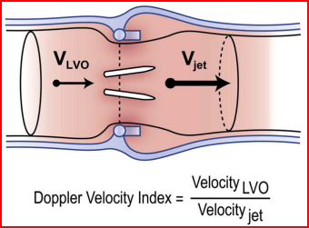
DOPPLER VELOCITY INDEX
DVI had a sensitivity, specificity, positive and negative predictive values, and accuracy of 59%, 100%, 100%, 88%, and 90%, respectively for valve dysfunction.
Notes:
Schematic representation of the concept of the DVI.
Velocity across the prosthesis is accelerated through the jet
from the LVO tract. DVI is the ratio velocity in the LVO (Vlvo)to
that of the jet (Vjet
)

Slide 67
DOPPLER VELOCITY INDEX
Is the Ratio of the proximal flow velocity in the LVOT to the flow velocity through the aortic prosthesis in aortic PHV or The ratio of flow velocity through the Mitral prosthesis to the flow velocity across LVOT
Time velocity time integrals may also be used in Place of peak
velocities
ie., DVI for Aotic Valve =V_{LVOT} / V_{PrAv} or VTI _{LVOT} /VTI _{PrAv}
DVI for Mitral Valve = V_{Pr Mv} /V _{LVOT} or VTI _{PrMv}/ VTI _{PrAV}

Slide 68
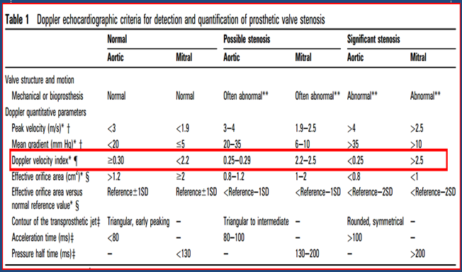
DVI can be helpful to screen for valve stenosis, particularly when the
  Crosssectional area of the LVOT cannot be obtained
DVI is always less than one, because velocity will always accelerate through the prosthesis.
DVI is not affected by high flow conditions
Disadvantage
Does not distinguish obstruction due to PPM or intrinsic
dysfunction
It depends on the size of LVOT.
Notes:
DVI is always less than unity, because velocity will always
accelerate through the prosthesis. A DVI < 0.25 is highly suggestive of
significant valve obstruction.
Similar to EOA, DVI is not affected
by high flow conditions through the valve, including AR, whereas blood
velocity and gradient across the valve are.

Slide 69
PROSTHETIC TRICUSPID & PULMONARY VALVE STENOSIS

Slide 70
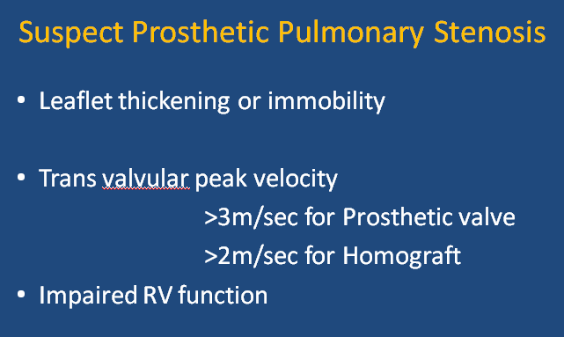
Suspect prosthetic tricuspid stenosis if
Prosthetic valve leaflet morphology and moblity abnormal
Peak velocity >1.7 m/sec
Mean Gradient ≥ 6mm of Hg
PHT at least 230msec

Slide 71
Evaluation of high gradient across the Prosthetic heart valve
Causes of High velocity or gradient across the prosthetic valve
Prosthetic valve stenosis or obstruction.
Patient prosthesis mismatch (PPM).
High flow conditions.
Prosthetic valve regurgitation.
Localised high central jet velocity in bileaflet
mechanical valves.
Increased heart rate.

Slide 72
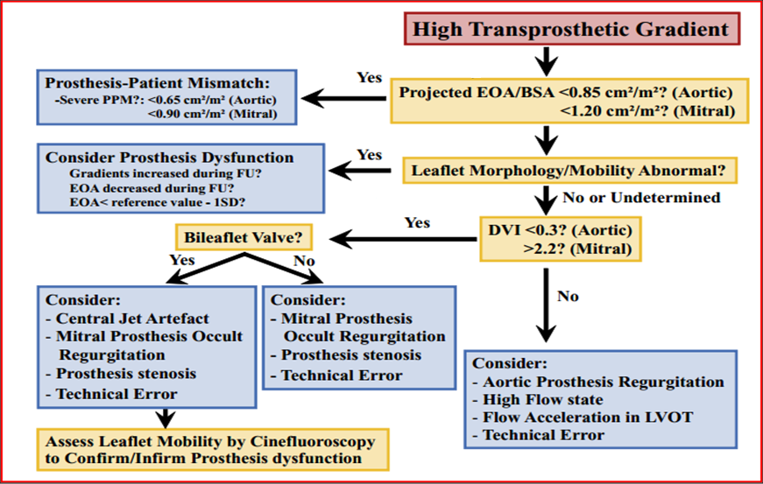
Algorithm for interpreting abnormally high transprosthetic pressure gradients

Slide 73
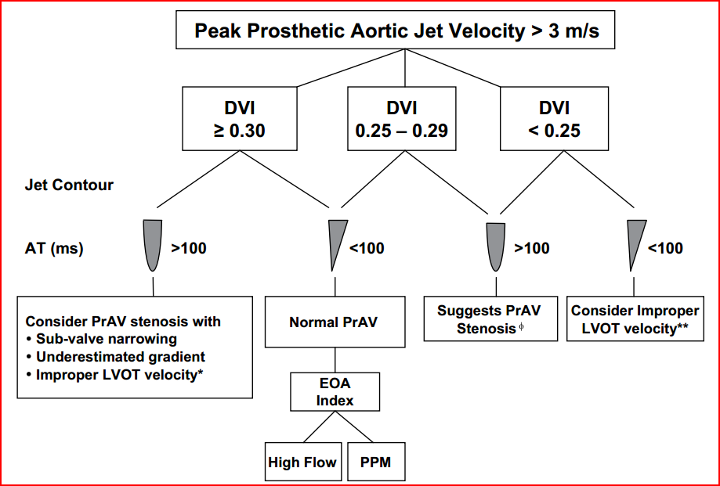
Algorithm for interpreting high velocity across aortic prosthetic valve

Slide 74
DETECTION AND QUANTIFICATION OF
PROSTHETIC VALVE REGURGITATION

Slide 75
Physiologic Regurgitation.
Closure backflow (necessary to close the valve)
Leakage backflow (after valve closure)
  Narrow (Jet area < 2 cm² and jet length <2.5 cm
  Short in duration
  Symmetrical
Low(nonaliasing) velocities
Regurgitant fraction of <10% to 15%.
Pathologic Regurgitation.
Always r/o whether Paravalvular or Valvular

Slide 76
Patterns of Physiological regurgitation
Bioprosthetic Valve:
Small central regurgitation
Bileaflet valve:
Two criss cross jet parallel to the plane of
leaflet opening
Tilting Disc: Regurgitation away from the
sewing ring at the edge of major orifice
Single disc with central strut ( Medronic Hall)
Small central jet around the central hole
of the disc

Slide 77
Pathological Regurgitation features
Eccentric or Large jet
Marked variance on the colour flow density
Jet that originates near the sewing ring
Visualisation of the proximal flow acceleration region on the LV side of Mitral valve

Slide 78
Prosthetic Mitral regurgitation Echo Evaluation

Slide 79
Prosthetic Mitral regurgitation
Echo Evaluation
Qualitative parameters
Quantitative parameters
Color flow jet areas
Flow convergence
Jet density
Jet contour
Pulmonary venous flow
Doppler velocity index
Vena contarcta width.
Regurgitant volume.
Regurgitant fraction.
EROA.
Indirect Signs
LA ,LV size & PHTN.

Slide 80
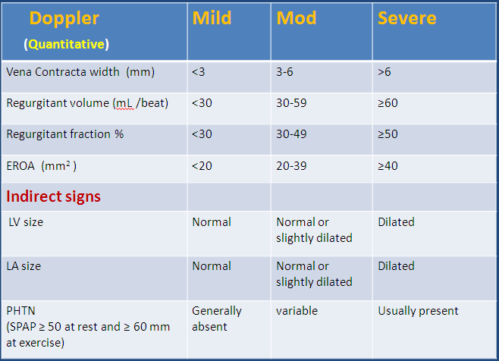
Prosthetic Mitral regurgitation severity
Valve structure and motion | Mild | Mod | Severe
Mechnaical or bioprosthetic | Usually normal | Usually abnormal | Usually abnormal
Doppler parameters ( Qualitative or Semiquantitative )
Color flow jet areas | Small central jet <4 cm² or <20% of LA area |  | Large central jet >8cm² or >40% of LA area or variable size wall impinging jet swirling in LA
Flow convergence | None | Intermediate | Large
Jet density(CW) | Incomplete or faint | Dense | Dense
Jet contour(CW) | Parabolic | Usually parabolic | Early Peaking triangular
Pulmonary venous flow(PW) | Systolic dominance | Systolic blunting | Systolic flow reversal
Doppler velocity index(PW) | <2.2 | 2.2-2.5 | >2.5

Slide 81
Aortic regurgitation

Slide 82
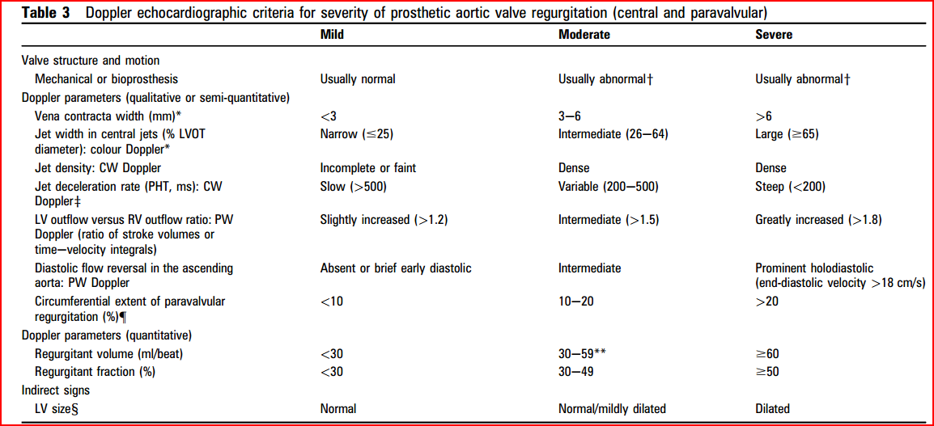

Slide 83
Regurgitant jet area calculation is difficult due to
artifact & shadowing
Retrograde systolic flow in one or more pulmonary
vein is specific for significant MR
TEE is superior to detect reversal of flow in pulmonary
vein mitral prosthesis.
PISA method is difficult to apply in PMV regurgitation
as eccentric jet or multiple jets

Slide 84
Paravalvular regurgitation severity
Regurgitant Jet
<10% of the sewing ring : Mild
10- 20 % of the sewing ring : Moderate
>20% of the sewing ring : Severe

Slide 85
Limitation of Echo in PHV assessment
IN QUANTIFICATION OF PHV REGURGITATION
Para valvular jet, Eccentric jet & Multijet
difficult to quantify
EVALUATION OF PROSTHETIC LEAFLET MOBILTY
TTE and TEE has limited sensitivity for the
detection of abnormalities of leaflet
morphology and mobility
EVALUATION OF PVE
TTE and TEE are less sensitive in detection of PVE

Slide 86
COMPLICATION OF PROSTHETIC HEART VALVES

Slide 87
Complication related to PHV
Operative Mortality
Perioperative MI
Prosthetic Valve Dehiscence
Prosthetic valve endocarditis
Thrombo emboli
Hemorrhage with anti coagulant therapy
Patient-Prosthetic mismatch
Hemolysis
Prosthetic Valve Dysfunction
due to
Obstruction
Regurgitation
Structural Failure
Late Mortality
Prosthetic replacement due to
complication

Slide 88
Patient prosthesis mismatch

Slide 89


Patient Prosthesis Mismatch
Valve prosthesis–patient mismatch (VP–PM) described in 1978 by Dr. Rahimtoola.
PPM occurs when EOA of a normally functioning prosthetic valve is too small in relation to the body size resulting in abnormal gradient across the valve.
Indexed EOA (EOA/BSA) is the parameter widely used to identify and predict PPM

Slide 90


Prevention of PPM
Avoided by systematically
  Calculating the projected indexed EOA of the prosthesis
  Model with better hemodynamic performance eg Stentless valve
  Aortic root enlargement to accommodate a larger size of the same prosthesis model.
  Supra annular placement: Prevents PPM IN 98% of AVR
  (The prevention of PPM in the mitral position difficult than in the aortic position because valve annulus enlargement or stentless valve implantation is not an option in this situation)

Slide 91
Prosthetic valve thrombus and Pannus

Slide 92
Prosthetic valve obstruction
Pure thrombus 75%
Pure pannus 10%
Combination of pannus and thrombus 12%

Slide 93


VALVE THROMBOSIS
Definition
Any thrombus in the absence of infection attached to or near the operated valve that occclude the path of blood flow or impede the operation of the valves

Slide 94

Pannus
It is is a membrane of granulation tissue as an response to healing and is avascular in nature
Injured pannus can predispose a thrombotic process and a chronic thrombus can trigger intravascular growth factors that promotes pannus growth.
This is more common with tilting disc on the side of minor orifice.

Slide 95

Pannus vs Thrombus
THROMBUS | PANNUS
Shorter time from valve insertion to valve dysfunction(62 days ) | Longer(178 days)
Shorter duration of symptoms (9days) | Longer ( 305 days)
Lower rate of adequate anticoagulation (21%) | Higher rate of adequate anticoagulation (89 %)
Greater total mass length (2.8cm), primarily due to extension into the LA, Mostly it is mobile | Smaller -1.2 cm firmly fixed (minimal mobility) to the valve apparatus
Less echo-dense | Highly echogenic (due to fibrous composition)
Associated with spontaneous contrast, Common in mitral and tricuspid position | Common in aortic position Para valve jet suggests pannus

Slide 96
Structural valve degeneration

Slide 97
Structural valve degeneration
Definition
Any change in function(decrease in one NYHA class or more) of an operated valve including
Operated valve dysfunction or deterioration exclusive of infection or thrombus as determined by the reoperation/autopsy or clinical investigation
Wear,fracture,popet escape,calcification,
leaflet tear ,stent creep, and suture line disruption of components of an operated valve

Slide 98


Structural valve degeneration
SVD is the most common cause of Bio PHV failure
Freedom from structural valve degeneration
Stented porcine valves : 30- 60% at 15 years
Pericardial valves : 86% at 12 years
Mortality for reoperation for SVD is 2- 3times than first operation.
Types of degeneration
CALCIFIC DEGERATION
NON CALCIFIC DEGERATION ( 30 %)
Sequele of degeneration
PHV Stenosis
PHV Regurgitation
or Both

Slide 99
Mechanical PHV Structural failure
Strut fracture
Leaflet escape
Occluder dysfunction due to lipid adsoption

Slide 100
Prosthetic valve infective endocarditis

Slide 101

Early endocarditis < 60 days P.O.D- perioperative bacteremia from skin/wound infections/contaminated intravascular devices.
Organisms: Staphylococcus epidermidis, S. aureus, gram-negative bacteria, diphtheroids, and fungi.
Late prosthetic-valve endocarditis (>60 days POD) is usually caused by the organisms responsible for native-valve endocarditis, most often streptococci.

Slide 102


Site of vegetation
Mechanical valves:
Between the sewing ring & annulus and
cause paravalvular abscess, dehiscence,
peudonaeurysm, fistulas
Bioprosthetic valve:
IE effects the valve leaflets and cause
cusp tear perforation, and vegetation

Slide 103
Paravalvular regurgitation

Slide 104

Paravalvular regurgitation
Causes
Infection
Suture dehiscence or fibrosis
Calcification of native annulus causing inadequate
contact between the sewing ring and annulus
More common with the trans catheter aortic valve implantation
Mild Paravalvular Regurgitation good prognosis require frequent monitoring

Slide 105
Thank u

Slide 106
QUIZ

Slide 107

Q No .1
Name of this person?

Slide 108

Q.No 2
Name the Complication of this Bileaflet prosthetic valve.

Slide 109


Q.No.3
What does this two cinefluroscopy images of the Tricuspid Bileaflet PHV
show? ( pictures are of the same patient 8 hrs apart?

Slide 110

Q.No.4
What does this spectral doppler tracing show? Tracing taken from A5C through Aortic PHV?
Notes:
(
A
) Continuous-wave Doppler recording from the cardiac
apex. An elevated peak-systolic transprosthetic gradient of
64 mmHg is noted in the three beats, indicating prosthetic valve
obstruction. In the second beat, an acute and severe intermittent
aortic regurgitant flow (arrow) is seen with a triangular velocity
profile and a rapid deceleration slope, indicating a quick equili-
bration between left ventricular and aortic-diastolic pressures. In
this beat, closing signals cannot be seen and the valve stays open
causing free aortic regurgitation. In the next beat, an increase in
the systolic aortic flow velocity is seen.
Intermittent aortic regurgitation (AR) is an unusual complication after a mechanical prosthetic replace-
ment. We describe a rare case of intermittent dysfunction of a bileaflet mechanical aortic prosthetic
valve in a 41-year-old man with a 21 mm Tri-technologies prosthetic valve implanted 4 years before.
Transthoracic echocardiography (TTE) before discharge was normal and prosthesis
–
patient mismatch
was ruled out. He was admitted to our hospital because of mild dyspnoea at effort. TTE revealed
acute and severe intermittent AR. The patient underwent surgery, during which abnormal proliferation
of subvalvular pannus overgrowth on the inflow aspect of the prosthesis was found impeding the normal
closure of one of the discs of the prosthesis. The pannus formation was resected, the Tri-technologies
prosthetic valve was prophylactic explanted and a 23 mm St Jude Medical bileaflet mechanical prosthe-
sis valve was implanted. We describe the role of TTE and the limitation of the cinefluoroscopy in the
diagnosis of Tri-technologies prosthetic dysfunction

Slide 111
Q.No .5.
Severe Prosthetic Aortic stenosis include all except
a) Peak velocity > 4m/sec
b) Mean Gradient > 35mm of Hg
c) DVI >0.25
d) Acceleration Time >100 msec
e) EOA : <0.8

Slide 112
Q.No .6
What type of valve is this?
EDWARD SAPIEN SELF EXPANDABLE
CORE VALVE BALLOON EXPANDABLE
EDWARD SAPIEN BALLOON EXPANDABLE
CORE VALVE SELF EXPANDABLE

Slide 113

Q.No .7
Male patient presented with PUO 1 month after Aortic valve replacement.
What is the echo finding? PLAX & SHORT AXIS images.

Slide 114
Q.No .8
Para valvular regurgitation is said to be severe if regurgitation
is _____% of the sewing ring circumferance?
a) >20%
b) >30%
c) >40%
d) >50%

Slide 115
Q.No .8
Features of Physiological regurgitation?
A) Jet area < 2 cm² and jet length <2.5 cm
B) Jet area > 2cm² but < 5cm² and jet length
<2.5 cm
C) Jet area >2cm² and jet length >2.5cm
D) jet area of >5cm² and jet Length of 2.5 cm

Slide 116

Q.No.9
What does this PLAX IMAGES show?

Slide 117
Q.No 10
Severity Aortic PPM is defined as
a) Indexed EOA ≤0.65 cm² /m²
b) Indexed EOA ≤0.85 cm² /m²
c) Indexed EOA ≤1.2 cm² /m²
d) Indexed EOA ≤0.9 cm² /m²

Slide 118

Q.No 11
Probable valve type producing this type of Doppler
Spectral signal ?

Slide 119
Q.No 12
Identify the abnormality?

Slide 120

ANTICOAGULATION MANAGEMENT

