Slide 1
ABDOMINAL AORTA
Dr.Himal Raj M

Slide 2
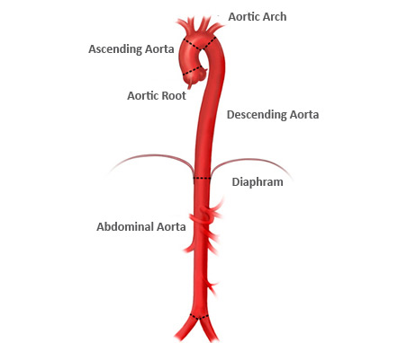
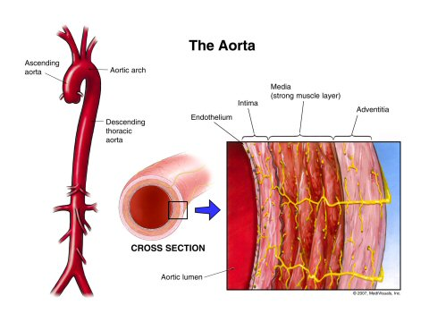
z
DIAPHRAGM

Slide 3
Abdominal aorta
Begins at aortic opening of diaphragm
In front of lower border of T12
Descending in front of vertebral column
Ends in front of lower part of body of L4 vertebra,1.25 cm to left of median plane
By dividing into right and left common iliac arteries

Slide 4
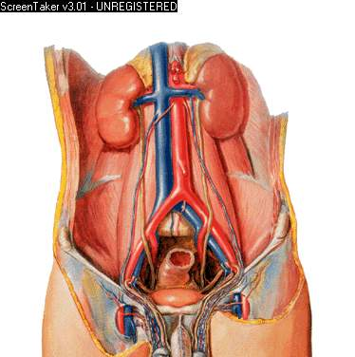

Slide 5
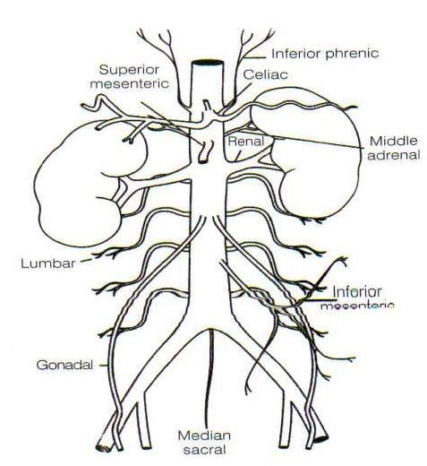
Branches of the abdominal aorta
Visceral Branches
Celiac.
Superior Mesenteric.
Inferior Mesenteric.
Middle Suprarenals.
Renals.
Internal Spermatics.
Ovarian (in the female)
Parietal Branches
Inferior Phrenics.
Lumbars.
Middle Sacral.
Terminal Branches
Common Iliacs.

Slide 6
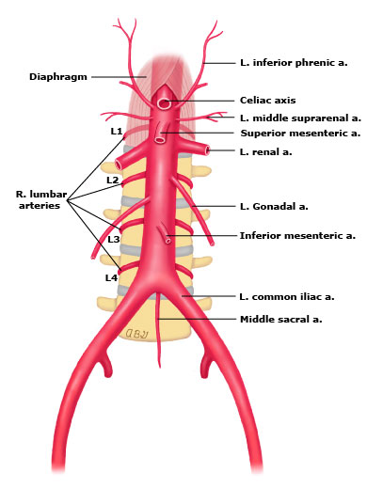

Slide 7
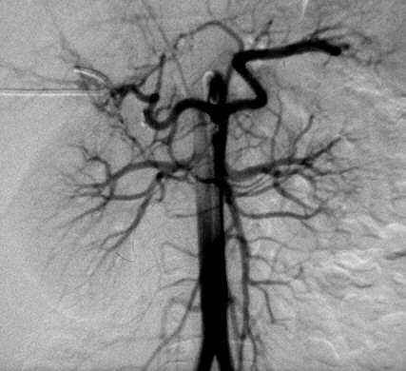
1.Abdo Aorta
2.Coeliac trunk
Lt gastric A
Splenic A
Hepatic A
3. S M A
4. I M A
5. Lt Renal A
6. Rt Renal A
a
b
AP VIEW
c
2
5
6
1
3
4

Slide 8
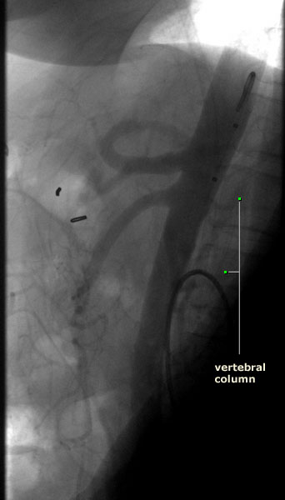
LATERAL VIEW
Catheter
Celiac trunk
Superior mesenteric artery
Abdominal aorta

Slide 9
Coeliac Artery
Short thick trunk
≈1.25 cm length
Arises from the front of the aorta, just below the aortic hiatus of the diaphragm
Between T12 & L1
Passing nearly horizontally forward
3 large branches
  Left gastric A - smallest
  Hepatic A
  Splenic A - largest
Notes:
The Left Gastric Artery (a. gastrica sinistra; gastric or coronary artery), the smallest of the three branches of the celiac artery, passes upward and to the left, posterior to the omental bursa, to the cardiac orifice of the stomach. Here it distributes branches to the esophagus, which anastomose with the aortic esophageal arteries; others supply the cardiac part of the stomach, anastomosing with branches of the lienal artery. It then runs from left to right, along the lesser curvature of the stomach to the pylorus, between the layers of the lesser omentum; it gives branches to both surfaces of the stomach and anastomoses with the right gastric artery.
9

Slide 10
Left gastric artery
Smallest branch
Runs along lesser curvature of stomach
Ends by anastomosing with Rt gastric artery
Branches-esophageal
-gastric

Slide 11
Common hepatic artery
Ends by dividing into Rt and Lt hepatic artery at porta hepatis
Branches – gastroduodenal artery
-Rt gastroepiploic
-Superior pancreaticoduodenal
- Rt gastric artery
- Supraduodenal artery
- Cystic artery

Slide 12
Splenic artery
Largest branch
Runs along upper border of pancreas and lienorenal ligament
Ends at hilum of spleen by dividing into 5-7 splenic branches
Branches- Pancreatic branches
- Short gastric artery
- Lt gastroepiploic artery

Slide 13
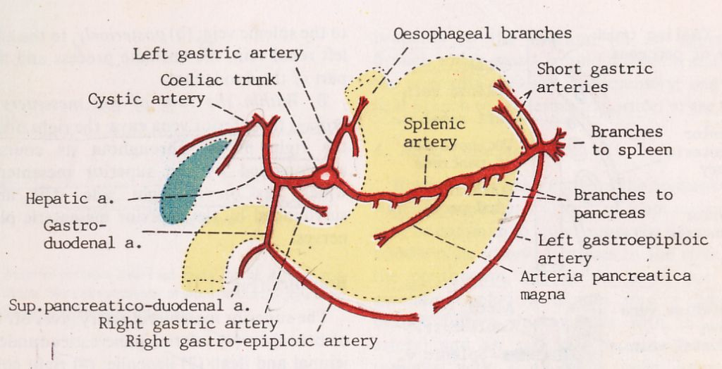
Notes:
The Hepatic Artery (a. hepatica) in the adult is intermediate in size between the left gastric and lienal; in the fetus, it is the largest of the three branches of the celiac artery. It is first directed forward and to the right, to the upper margin of the superior part of the duodenum, forming the lower boundary of the epiploic foramen (foramen of Winslow). It then crosses the portal vein anteriorly and ascends between the layers of the lesser omentum, and in front of the epiploic foramen, to the porta hepatis, where it divides into two branches, right and left, which supply the corresponding lobes of the liver, accompanying the ramifications of the portal vein and hepatic ducts. The hepatic artery, in its course along the right border of the lesser omentum, is in relation with the common bile-duct and portal vein, the duct lying to the right of the artery, and the vein behind. 9 Its branches are: 10 Right Gastric.
Gastroduodenal ( Right Gastroepiploic. Superior Pancreaticoduodenal). Cystic.
The Lienal or Splenic Artery (a. lienalis), the largest branch of the celiac artery, is remarkable for the tortuosity of its course. It passes horizontally to the left side, behind the stomach and the omental bursa of the peritoneum, and along the upper border of the pancreas, accompanied by the lienal vein, which lies below it; it crosses in front of the upper part of the left kidney, and, on arriving near the spleen, divides into branches, some of which enter the hilus of that organ between the two layers of the phrenicolienal ligament to be distributed to the tissues of the spleen; some are given to the pancreas, while others pass to the greater curvature of the stomach between the layers of the gastrolienal ligament. Its branches are: 16 Pancreatic.
Short Gastric.
Left Gastroepiploic
The pancreatic branches (rami pancreatici) are numerous small vessels derived from the lienal as it runs behind the upper border of the pancreas, supplying its body and tail. One of these, larger than the rest, is sometimes given off near the tail of the pancreas; it runs from left to right near the posterior surface of the gland, following the course of the pancreatic duct, and is called the arteria pancreatica magna. These vessels anastomose with the pancreatic branches of the pancreaticoduodenal and superior mesenteric arteries
The short gastric arteries (aa. gastricæ breves; vasa brevia) consist of from five to seven small branches, which arise from the end of the lienal artery, and from its terminal divisions. They pass from left to right, between the layers of the gastrolienal ligament, and are distributed to the greater curvature of the stomach, anastomosing with branches of the left gastric and left gastroepiploic arteries. 18 The left gastroepiploic artery (a. gastroepiploica sinistra) the largest branch of the lienal, runs from left to right about a finger’s breadth or more from the greater curvature of the stomach, between the layers of the greater omentum, and anastomoses with the right gastroepiploic. In its course it distributes several ascending branches to both surfaces of the stomach; others descend to supply the greater omentum and anastomose with branches of the middle colic.
13

Slide 14
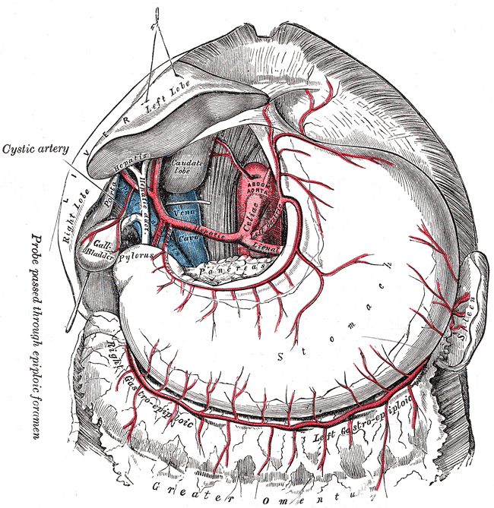

Slide 15
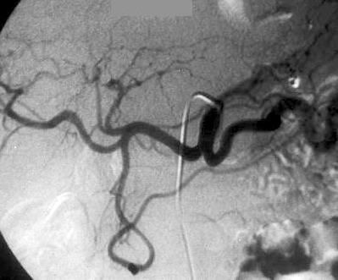
1.Coeliac A
2.Lt gastric A
3.Hepatic A
4.Splenic A
5.Gastroduodenal A
ANTERIO-POSTERIOR VIEW
2
3
1
4
4

Slide 16
Superior Mesenteric Artery
Large vessel
Arises from front of aorta, at L1, ~1.25 cm below Coeliac A
Passes downward and forward, to the right iliac fossa
Supply small intestine (expt superior Duo),
Cecum, Asc Colon & Rt ½ Transverse Colon

Slide 17
SMA-Branches
Inferior Pancreatico-duodenal
Middle Colic
Right Colic
Ileocolic
Intestinal

Slide 19
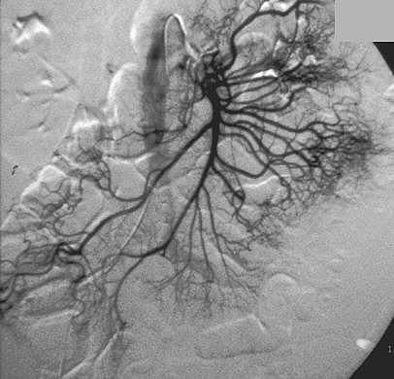
1.Abd Aorta
2.S M A
3.Middle colic A
4.Rt colic A
5.Ileocolic A
6. Intestinal A
7.Appendicular
1
2
3
4
5
6
7

Slide 20
Inferior Mesenteric Artery
Smaller than SMA
Arises from aorta at L3, about 3 or 4 cm above its division
Passes downward, posterior to the peritoneum
Continued into pelvis as Superior hemorrhoidal artery & ends on the upper rectum
Supply Lt ½ transverse colon, descending & sigmoid colon, and most of the rectum

Slide 21
Inferior Mesenteric Artery branches
Left Colic A
Sigmoid branches
Superior Hemorrhoidal A

Slide 23
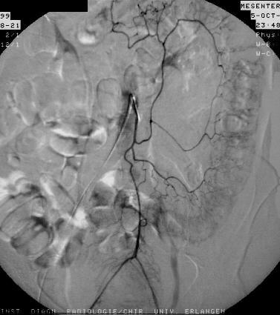
1.Inf mesentric A
2.Lt colic A
3.Marginal A
4.Sigmoid A
5.Superior hemorrhoidal A
3
1
2
4
5

Slide 24
Superior Hemorrhoidal Artery
Form a series of loops around lower rectum
Communicate with
  Middle hemorrhoidal branches of Internal Iliac A
  and
  Inferior hemorrhoidal branches of Internal pudendal A (branch of Internal Iliac A)

Slide 25
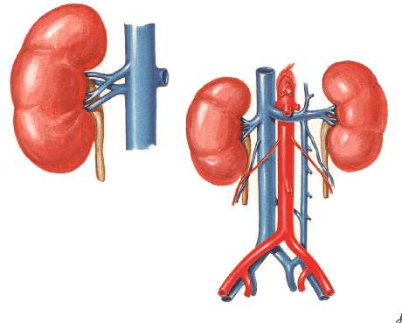
Renal arteries
Two large arteries
Arises from side of aorta, immediately below SMA
Nearly a right angle with the aorta
Right is longer than left
Before reaching hilus of the kidney, each artery divides into four or five branches
Left is somewhat higher than the right

Slide 26
AP VIEW
Lt Renal arteries
Rt Renal arteries

Slide 27
Common Iliac Arteries
Abdominal Aorta divides, on Lt side of L4
Each about 5 cm length
Rt Common Iliac A -somewhat longer than the Lt
Each divide, opposite the intervertebral fibrocartilage between L5 & S1
2 branches→
  External Iliac A
  &
  Internal Iliac A (Hypogastric A )

Slide 28
THANK YOU

